Slide 1
MSP 430 TIMERS
P.RAJESH
Dept of E.C.E
JNTUA CEA

Slide 2
MSP430 Real-Time Clock
Real-Time Clock
In MSP430 if the Basic Timer1 module is present, a Real-Time Clock (RTC)
Module is also present to provide real measurement of time.
Keeping track of “wall time” can be such a common thing to do, the
hardware designers provided a hardware module to do it for you.
Other uCs might require software keep track of the time based on
hardware-generated interrupts.
The RTC module can generate an interrupt as an “alarm clock” function.

Slide 3
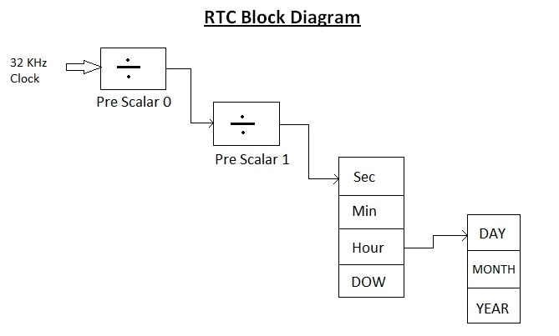
The prescaler takes the basic timer clock frequency (which may be the CPU clock frequency or may be some higher or lower frequency) and divides it by some value before feeding it to the timer, according to how the prescaler register(s) are configured.

Slide 4
Additional features of RTC:
All RTC’s work in LPM 3
The RTC_B and RTC_C can be operates in LPM 3.5 due to RTC_B & RTC_C are access the LF crystal directly.
RTC_B / RTC_C provide BCD conversion
RTC_A can be used as 32-bit counter (rather than calendar mode).
Counter mode generates an overflow interrupts.

Slide 5
MSP430 Basic Timer1
Some MSP430 varieties have a Basic Timer1 module.
The timer consists of two 8-bit register halves that can be used as independent 8-bit
timers or cascaded as a single 16-bit timer.
When the timer overflows, a flag is set in a flag register.
The flag can trigger an optional, maskable interrupt.
If no interrupts, software must poll and manually clear the flag.
If using interrupts, hardware automatically clears the flag and calls the associated ISR.
Could be used to generate a real-time interrupt.

Slide 6
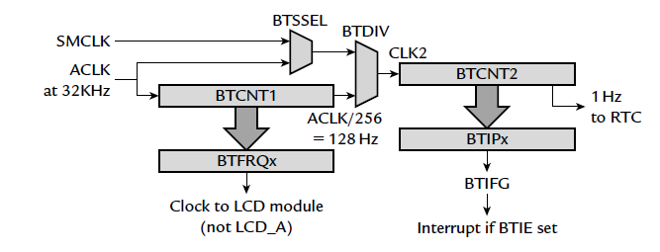
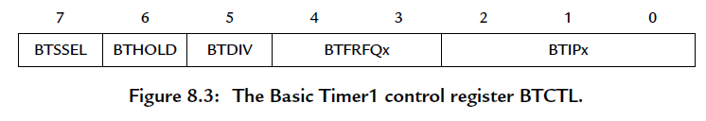
8-bit Reg
8-bit Reg
Basic Timer Select Reg
Basic Timer Frequency Reg
Basic Timer Sub
main clock select
Basic Timer Interrupt Reg
Basic Timer Hold
Basic Timer Divide

Slide 7
real-time clock driven by a signal at 1Hz from Basic Timer1.
BTCNT1: (Basic Timer Control 1)
Takes its input from ACLK and provides the clock for the LCD module at frequency fLCD.
The two BTFRFQx bits select the value of fLCD, which can vary from fACLK/256 to fACLK/32 in powers of 2.
It is assumed that fACLK = 32 KHz. This gives fLCD from 128 Hz to 1 KHz, which should be suitable for the LCD.
BTCNT2: (Basic Timer Control 2)
Can be used independently of BTCNT1, in which case the BTSSEL(Basic Timer Sub main clock select) bit selects the clock from ACLK or SMCLK.
For longer intervals, BTCNT2 can be clocked from the output of BTCNT1 at a frequency of fACLK/256.
Set the BTDIV bit to cascade the counters in this way.
Setting the BTHOLD bit stops BTCNT2, but stops BTCNT1 only if BTDIV is also set.

Slide 8
Timer/Counter Basics
15 |  |  |  |  |  |  |  |  |  |  |  |  |  |  | 0
TAR
Counter
Register
Counter Overflow Action
Interrupt (TAIFG)
Clock Input
Clock
GPIO Pin (TACLK)
Input  Counter  Action
Notes
Timers are often called “Timer/Counters” as a counter is the essential element
“Timing” is based on counting inputs from a known clock rate
Notes:
Counter
A counter is the fundamental hardware element found inside a timer.
The other essential element is a clock input.
When the timer finishes, it can generate some action (like an interrupt).

Slide 9
Timer/Counter Basics
15 |  |  |  |  |  |  |  |  |  |  |  |  |  |  | 0
TAR
Counter
Register
Counter Overflow Action
Interrupt (TAIFG)
Clock Input
Clock
GPIO Pin (TACLK)
 |  |  |  |  |  |  |  | FFFF
 |  |  |  |  |  |  | FFFE
 |  |  |  |  |  | FFFD
 |  |  |  | 04
 |  |  | 03
 |  | 02
 | 01 |  |  |  |  |  |  |  |  | 01
Interrupt occurs when timer overflows back to zero
Each pulse of clock input increments the counter register
Notes
Timers are often called “Timer/Counters” as a counter is the essential element
“Timing” is based on counting inputs from a known clock rate
Actions don’t occur when writing value to counter
Notes:
As you see here, the counter is incremented each time it’s clocked. A 16-bit timer counts from zero up to 0xFFFF (64K).
When the counter reaches it reaches its maximum value, it overflows – that is, it returns to zero and starts counting upward again. Most timer peripherals can generate an interrupt when this overflow event occurs; on TIMER_A, the interrupt flag bit for this event is called TAIFG (TIMER_A Interrupt Flag).
The clock input signal for TIMER_A (named TACLK) can be one of the internal MSP430 clocks or a signal coming from a GPIO pin.
Often called “Timer/Counters”, because they provide both capabilities. They can generate interrupts or waveforms using a specific time-base … or could be used to count external events occurring in your system.
One final note about the MSP430 timers: they do not generate interrupts (or other actions) when you write to the counter register. For example, writing “0” to the counter won’t generate the TAIFG interrupt.

Slide 10

Frequency, Time Period, Resolution
With what resolution can we determine if an
event occurred here?
 timer interrupt
 timer interrupt
 timer interrupt
Time Period
Definitions
Frequency: How many times per second
Time Period: Amount of time between successive events
Resolution: Granularity in determining system events

Slide 11
Capture Basics
15 |  |  |  |  |  |  |  |  |  |  |  |  |  |  | 0
TAR
Counter
Register
Counter Overflow Action
Interrupt (TAIFG)
Clock Input
Clock
GPIO Pin (TACLK)
Capture Input signal triggers
transfer: Counter → Capture
Capture/Compare Register (CCR_{n})
Capture Actions
Interrupt (CCIFGn)
Signal peripheral
Modify pin (TAx.n)
Capture Input
CCInA
CCInB
Software
Notes
Capture time (i.e. count value) when Capture Input signal occurs
When capture is triggered, count value is placed in CCR and an interrupt is generated
Capture Overflow (COV): indicates 2nd capture to CCR before 1st was read
Notes:
Looking at some Capture details:
The Capture Input signal can be connected to a couple of different signals (CCInA, CCInB) or triggered via software.
The Capture Input hardware signals (CCInA, CCInB) are connected differently for each CCR register and device. You’ll need to refere the datasheet to see options for your device.
When a capture occurs… besides capturing the counter value… the CCR can trigger further actions:
CPU interrupt (CCIFGn)
Trigger another peripheral
Set/reset a pin
As we’ve seen (and will see again) TIMER_A/B/D have multiple CCR registers. Each CCR, though, has its own capture input signal.
As we just discussed, the Capture feature provides a deterministic method of capturing the count value when triggered. While handy, there is another important requirement for timers…

Slide 12
Compare Basics
15 |  |  |  |  |  |  |  |  |  |  |  |  |  |  | 0
TAR
Counter
Register
Counter Overflow Action
Interrupt (TAIFG)
Clock Input
Clock
GPIO Pin (TACLK)
when Counter = Compare
Compare Actions can occur
Capture/Compare Register (CCR_{n})
Compare Actions
Interrupt (CCIFGn)
Signal peripheral
Modify pin (TAx.n)
Notes
There are usually 2 to 7 compare registers (CCR’s), therefore up to 8 interrupts or signals can be generated
Counter must count-to Compare value to generate action
Notes:
… a compare action is triggered.
The compare actions can include:
Generating an interrupt to the CPU
Signaling another peripheral (e.g. triggering an ADC conversion), or
Changing the state of an external pin
The “modify pin” action is a very powerful capability.
Using the timer’s compare feature, we can create sophisticated PWM waveforms.
We look at generating a simple PWM signal in the optional lab exercise.

Slide 13
Timer _A
Is a general-purpose timer in the MSP430 and is included in all devices.
It was introduced in the section “Automatic Control: Flashing a Light by Polling Timer_A”
2 main parts in hardware
1. Timer Block : The core, based on the 16-bit register TAR.
There is a choice of sources for the clock, whose frequency can be divided down (prescaled).
The timer block has no output but a flag TAIFG is raised when the counter returns to 0.

Slide 14
Capture/compare channels: is based on a register TACCRn.
Compare: the current value of TAR with the value stored in TACCRn and update an output when they match; the output can again be either external or internal.
• Request an interrupt : by setting its flag TACCRn CCIFG on either of these events; this can be done even if no output signal is produced.
• Sample an input at a compare event; this special feature is particularly useful if Timer_A is used for serial communication in a device that lacks a dedicated interface.

Slide 15
Timer_A is modular and the number of capture/compare channels varies between devices.
Most have three channels but the smallest members of the MSP430F2xx family have only two and some earlier devices had more.
The number of channels is sometimes appended to the name as in Timer_A3.
Capture/compare channel 0 is special in two ways. Its register TACCR0 is taken over for the modulus value in Up and Up/Down modes, so that it is no longer available for its usual functions.

Slide 16
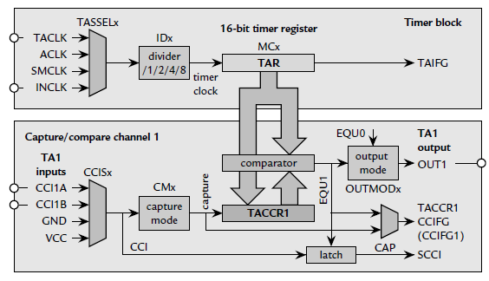

Slide 17
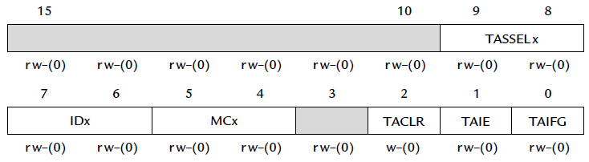
Timer_A Control Register: TACTL
Peripheral registers set the way the datasheet says:
rw-0 notation means: readable/writeable and initialized to 0 on PUC.
rw-(0) notation means: readable/writeable and initialized to 0 only on POR.

Slide 18
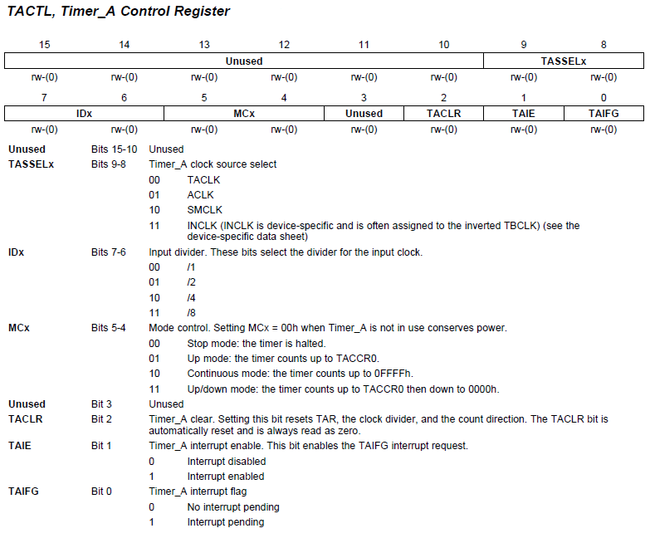
TACTL
TACTL = TASSEL_2 + MC_1; // src from SMCLK, up mode

Slide 19
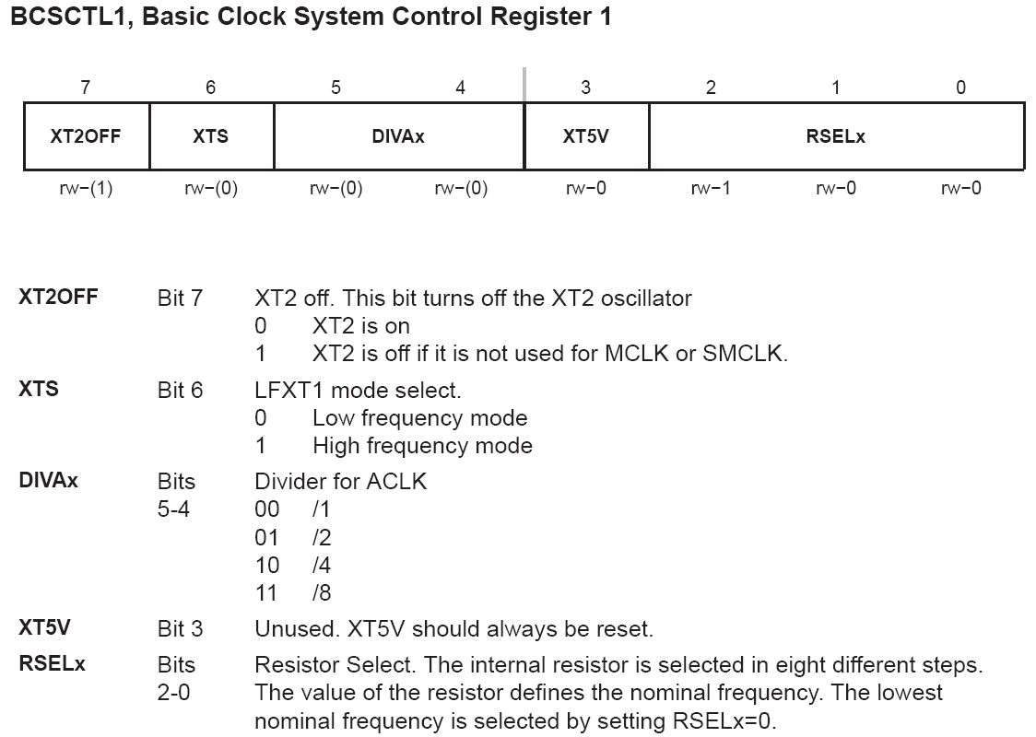

Slide 20
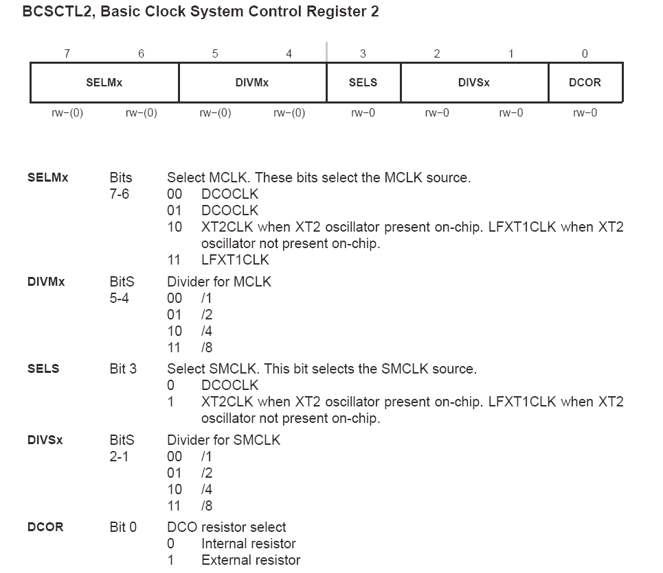

Slide 21
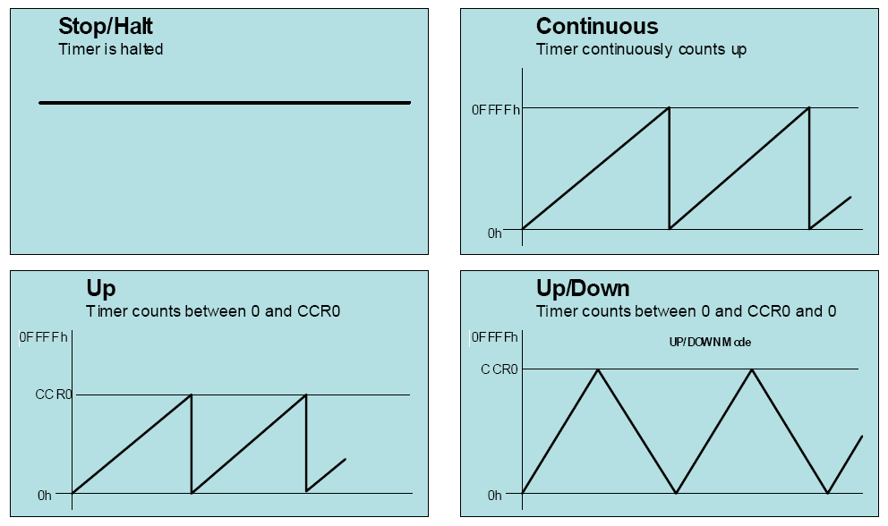
TIMER_A_stop( TIMER_A0_BASE );
Notes:
Oddly enough, one of the modes is that the timer can be “Stopped”.
Of course, one advantage here is that it isn’t consuming any power…

Slide 22
Timer Counting Modes Summary
TIMER_A_configureContinuousMode (…);
Timer_A can generate CPU interrupts whenever count returns to zero
Notes:
We just looked at the Continuous mode.
The counter counts up to FFFF and then rolls back over to zero.
When it does, the timer can generate a CPU interrupt … if you enable it to do so.

Slide 23
Timer Counting Modes Summary
Even more interrupts can be generated
TIMER_A_configureUpMode (…);
Notes:
The UP mode is similar to Continuous, except that instead of counting to FFFF, it counts UP until it reaches the value in the CCR0 register.
Notice that each timer period can generate TWO interrupts (rather than one).
Also, notice that the DriverLib function is now named TIMER_A_configureUpMode().
We’ll look more closely at both of these, in a minute…

Slide 24
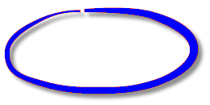
Timer Counting Modes Summary
CCR0 is a special – it can be used for UP and …
Even more interrupts can be generated
TIMER_A_configureUpMode (…);
Notes:
As a quick aside, for each TIMER, CCR0 is special, compared to the other CCR registers.
Besides having an interrupt dedicated to it, it’s the only one that can act as the “count-up-to” value.

Slide 25
Timer Counting Modes Summary
TIMER_A_configureUpDownMode (…);
CCR0 is special !!!
Notes:
Finally, the fourth mode is called UP/DOWN.
It’s similar to the UP mode… except rather than resetting back to zero, it just changes direction and COUNTS back down to zero.
This effectively doubles the timer’s period … in other words, it halves the frequency of the timer. This can be useful if you’re trying to get the timer to create a very slow frequency.
Also notice, how the timer can generate interrupts every time the counter hits a rail. That is, each time it changes direction.

Slide 26

Continuous Mode

Slide 27
Timer Counting Modes Summary
CCR0 is special !!!

Slide 28
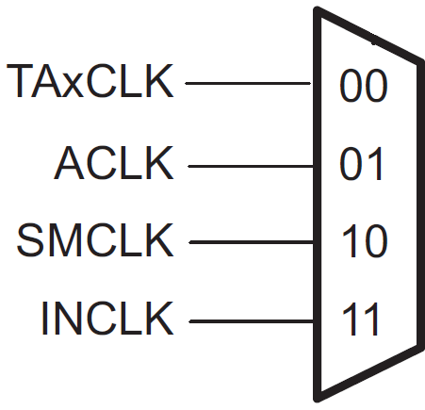
TAR in Continuous Mode
Divide
by 5-bits
(up to ÷ 64)
16-bit Counter
(TAR)
Interrupt
Enable
(TAIE)
TA0IFG
TIMER_A_configureContinuousMode( );
FFFFh
0h
Continuous mode TAR runs full range of 16-bit counter
INT occurs at count to 0 TAR must transition to zero – it won’t happen if you write 0 to TAR
TA0IFG
TA0IFG

Slide 29
Up Mode

Slide 30
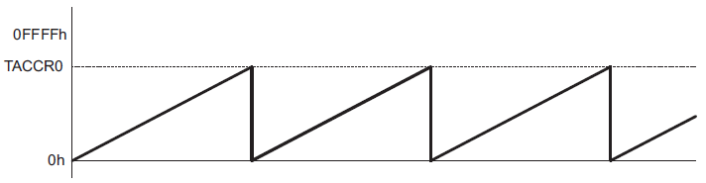
Modes of Operation: Up Mode
The up mode is used if the timer period must be different from 0FFFFh counts.
Timer period 100 → store 99 to TACCR0
When TACCR0 == 99, set TACCR0 CCIFG interrupt flag
Reset timer to 0 and set TAIFG interrupt flag
TAIFG is set, and Timer_A interrupts CPU

Slide 31
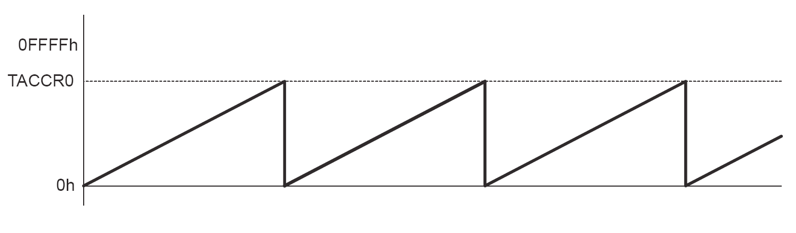
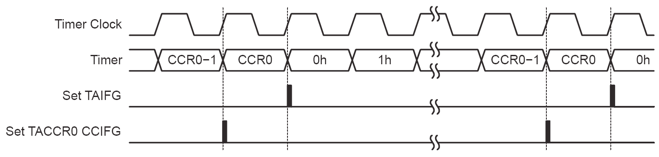

Slide 32
Timer Counting Modes Summary
Notes:
We’ve already looked at coding up the Continuous mode. Let’s take a closer look at one more of these configuration functions… UP

Slide 33
TAR in UP Mode
Divide
by 5-bits
(up to ÷ 64)
16-bit Counter
(TAR)
Interrupts
Enable
(TAIE)
TA0IFG
CCR0
CC0IE
CC0IFG
FFFFh
CCR0
0h
Notes:
As we said, the Up mode differs from the Continuous by resetting back to zero whenever the counter matches CCR0 (Capture and Compare Register 0).
You can see this with the green line shown here. It counts Up to the value found in CCR0, and then resets back to zero.
On the other hand, the grey dotted waveform shows how, in Continuous mode, the counter goes past CCR0 and all the way to 0xFFFF.
In Up mode, since we are using the CCR0 register, the timer can generate two interrupts:
TAIFG (for Timer0_A, this bit is called TA0IFG)
CC0IFG (for Timer0_A, this bit is actually called TA0CC0IFG)

Slide 34
TAR in UP Mode
Divide
by 5-bits
(up to ÷ 64)
16-bit Counter
(TAR)
Interrupts
Enable
(TAIE)
TA0IFG
CCR0
CC0IE
CC0IFG
UP mode Ints at ‘custom’ (higher) frequencies
FFFFh
CCR0
0h
CC0IFG
TA0IFG
CC0IFG
TA0IFG
CC0IFG
TA0IFG
Notes:
If you compare these two interrupts to the ONE found in Continuous mode, you’ll see they occur more frequently. This is a big advantage of the Up mode; your frequency is not limited to 2¹⁶ counts, but rather can be anywhere within the 16-bit counter’s range. (The downside is that you also have to configure the CCR0 registers.)

Slide 35
TAR in UP Mode
Divide
by 5-bits
(up to ÷ 64)
16-bit Counter
(TAR)
Interrupts
Enable
(TAIE)
TA0IFG
CCR0
CC0IE
CC0IFG
UP mode Ints at ‘custom’ (higher) frequencies
Both interrupts are generated 1-cycle apart
CC0IFG when TAR = CCR0
TA0IFG when TAR 0h
FFFFh
CCR0
0h
CC0IFG
TA0IFG
CC0IFG
TA0IFG
CC0IFG
TA0IFG
Notes:
BTW, You’re not seeing a color misprint; the two interrupts do not happen at the exact same time, but rather 1 cycle apart. The CC0IFG occurs when there is a compare match, while the TA0IFG interrupt occurs once the counter goes back to zero.

Slide 36
TAR in UP Mode
Divide
by 5-bits
(up to ÷ 64)
16-bit Counter
(TAR)
Interrupts
Enable
(TAIE)
TA0IFG
CCR0
CC0IE
CC0IFG
UP mode Ints at ‘custom’ (higher) frequencies
Both interrupts are generated 1-cycle apart
CC0IFG when TAR = CCR0
TA0IFG when TAR 0h
CCR0 is special CCR Only CCR0 affects TAR’s count in this way
CCR0 is a dedicated IFG, the rest are grouped
FFFFh
CCR0
0h
CC0IFG
TA0IFG
CC0IFG
TA0IFG
Notes:
The CCR0 (Capture and Control Register 0) is special. That is, it is special in comparison to the other CCR registers. It’s only CCR0 that can be used to define the upper limit of the counter in Up (or UpDown) mode. The other special feature of CCR0 is that it provides a dedicated interrupt (CC0IFG). In other words, there is an Interrupt Vector location dedicated to CC0IFG. All the other Timer_A interrupts share a common, “Grouped” interrupt vector location.

Slide 37
TAR in UP Mode
Divide
by 5-bits
(up to ÷ 64)
16-bit Counter
(TAR)
Interrupts
Enable
(TAIE)
TA0IFG
CCR0
CC0IE
CC0IFG
Timer_A_initUpMode( );
UP mode Ints at ‘custom’ (higher) frequencies
Both interrupts are generated 1-cycle apart
CC0IFG when TAR = CCR0
TA0IFG when TAR 0h
CCR0 is special CCR Only CCR0 affects TAR’s count in this way
CCR0 is a dedicated IFG, the rest are grouped
FFFFh
CCR0
0h
CC0IFG
TA0IFG
CC0IFG
TA0IFG
Notes:
As we just saw, the function TIMER_A_configureUpMode() is used to set up the timer for UP mode. Let’s look at this function…

Slide 38
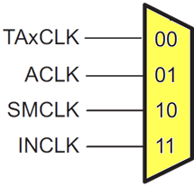
TAR in UP Mode
Divide
by 5-bits
(up to ÷ 64)
16-bit Counter
(TAR)
Interrupts
Enable
(TAIE)
TA0IFG
CCR0
CC0IE
CC0IFG
Most of the UP mode parameters are the same as Continuous mode:
Timer_A_initUpModeParam initParam = { 0 };
initParam.clockSource = TIMER_A_CLOCKSOURCE_ACLK;
initParam.clockSourceDivider = TIMER_A_CLOCKSOURCE_DIVIDER_1;
initParam. timerPeriod = 0xFFFF / 2;
initParam.timerInterruptEnable_TAIE = TIMER_A_TAIE_INTERRUPT_ENABLE;
initParam.captureCompareInterruptEnable_CCR0_CCIE = TIMER_A_CCIE_CCR0_INTERRUPT
initParam.timerClear = TIMER_A_DO_CLEAR;
initParam.startTimer = false;
Timer_A_initUpMode( TIMER_A0_BASE, &initParam );
\
Notes:
Like the Continuous mode function, TIMER_A_configureUpMode() lets us:
Chose which timer instance we want
Select an input clock
Divide down the clock
Clear the TAR counter
And, enable the interrupt that can occur when the counter rolls back over to zero

Slide 39
TAR in UP Mode
Divide
by 5-bits
(up to ÷ 64)
16-bit Counter
(TAR)
Interrupts
Enable
(TAIE)
TA0IFG
CCR0
CC0IE
CC0IFG
As we just discussed, the UP mode lets you specify a time ‘period’:
Timer_A_initUpModeParam initParam = { 0 };
initParam.clockSource = TIMER_A_CLOCKSOURCE_ACLK;
initParam.clockSourceDivider = TIMER_A_CLOCKSOURCE_DIVIDER_1;
initParam. timerPeriod = 0xFFFF / 2;
initParam.timerInterruptEnable_TAIE = TIMER_A_TAIE_INTERRUPT_ENABLE;
initParam.captureCompareInterruptEnable_CCR0_CCIE = TIMER_A_CCIE_CCR0_INTERRUPT
initParam.timerClear = TIMER_A_DO_CLEAR;
initParam.startTimer = false;
Timer_A_initUpMode( TIMER_A0_BASE, &initParam );
Notes:
What’s new is that this function lets you set the value in the CCR0 compare register. This effectively creates the count-up-to value.

Slide 40
TAR in UP Mode
Divide
by 5-bits
(up to ÷ 64)
16-bit Counter
(TAR)
Interrupts
Enable
(TAIE)
TA0IFG
CCR0
CC0IE
CC0IFG
Whether an interrupt should be generated when the counter equals that ‘period’ value:
Timer_A_initUpModeParam initParam = { 0 };
initParam.clockSource = TIMER_A_CLOCKSOURCE_ACLK;
initParam.clockSourceDivider = TIMER_A_CLOCKSOURCE_DIVIDER_1;
initParam. timerPeriod = 0xFFFF / 2;
initParam.timerInterruptEnable_TAIE = TIMER_A_TAIE_INTERRUPT_ENABLE;
initParam.captureCompareInterruptEnable_CCR0_CCIE = TIMER_A_CCIE_CCR0_INTERRUPT
initParam.timerClear = TIMER_A_DO_CLEAR;
initParam.startTimer = false;
Timer_A_initUpMode( TIMER_A0_BASE, &initParam );
Notes:
Also, you can determine whether a CPU interrupt is generated when the counter’s value matches that in CCR0.
If the comparison match is TRUE … and, if the CC0 IE bit is set … then the timer will set the TA0 CC0IFG bit and generate an interrupt to the CPU.

Slide 41
Up/Down Mode

Slide 42
Timer Counting Modes Summary
CCR0 is special !!!

Slide 43
TAR in UP/DOWN Mode
Divide
by 5-bits
(up to ÷ 64)
16-bit Counter
(TAR)
Interrupts
Enable
(TAIE)
TAIFG
CCR0
CC0IE
CC0IFG
TIMER_A_initUpDownMode( );
FFFFh
CCR0
0h
UP/DOWN mode TAR counts up & down
2x period of UP mode i.e. half the interrupts
Remembers count dir If TAR stopped then started, it keeps going in same direction
CC0IFG
TA0IFG
CC0IFG

Slide 44
TAR in UP/DOWN Mode
Divide
by 5-bits
(up to ÷ 64)
16-bit Counter
(TAR)
Interrupts
Enable
(TAIE)
TAIFG
CCR0
CC0IE
CC0IFG
FFFFh
CCR0
0h
UP/DOWN mode TAR counts up & down
2x period of UP mode i.e. half the interrupts
Remembers count dir If TAR stopped then started, it keeps going in same direction
2x the timer period
(i.e. twice as slow)
TA0IFG

Slide 45
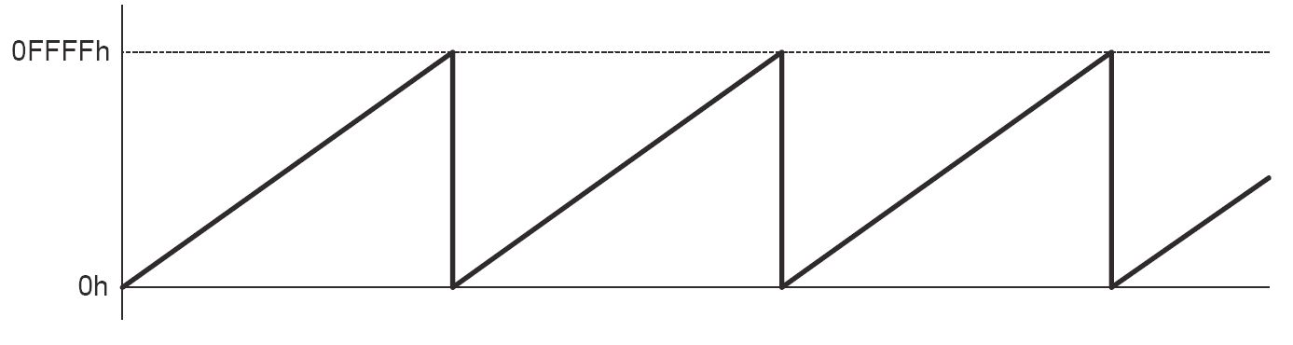
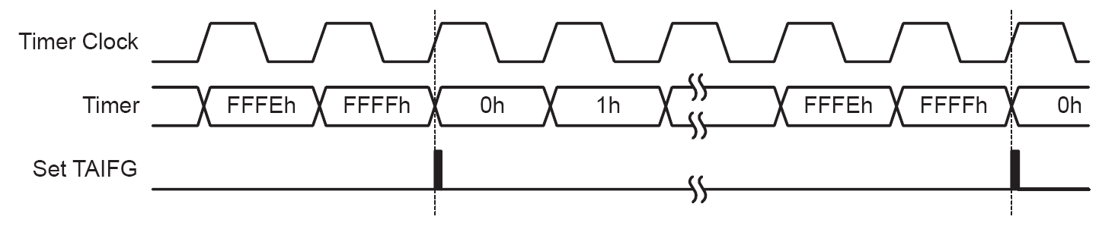
Modes of Operation: Continuous Mode
In the continuous mode, the timer repeatedly counts up to 0FFFFh and restarts from zero
The TAIFG interrupt flag is set when the timer resets from 0FFFFh to zero

Slide 46
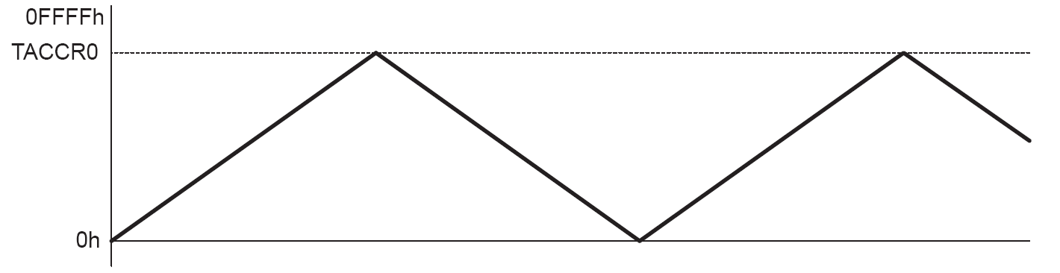
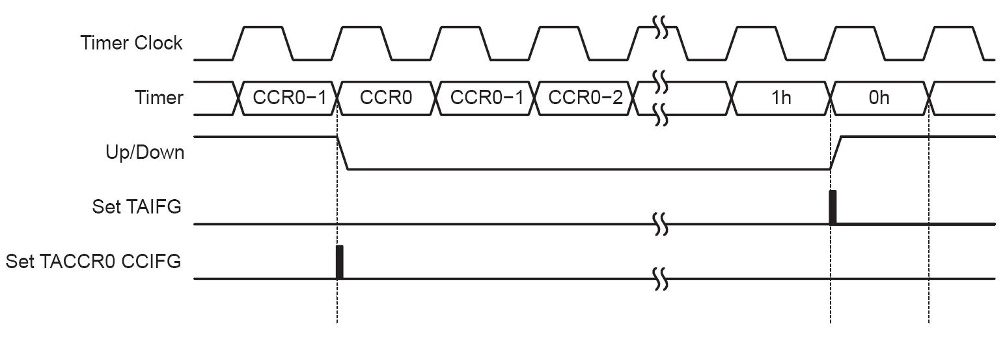
Modes of Operation: Up/Down Mode
The up/down mode is used if the timer period must be different from 0FFFFh counts, and if a symmetrical pulse generation is needed.
→ The period is twice the value in TACCR0.

Slide 47
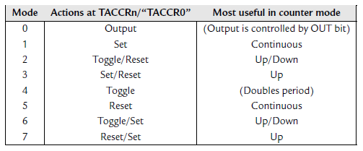
Output modes
Output modes for capture/compare channel n (not all are applicable to TACCR0) and the counter mode in which each is most useful. The precise point at which the ‘TACCR0’ actions.

Slide 48
Output (mode 0): In which output is controlled directly by the OUT bit in TACCTLn; TAR has no influence. It is as if the pin is used for normal, digital output but operated via Timer_A. This mode is used to set up the initial state of the output before compare events take over. For example, the first period of pulse-width modulation (PWM) may be erratic if this is not done, but it often does not matter.
Toggle (mode 4): Provides a simple way of switching a load on and off for equal times (50% duty cycle) and can be used even with channel 0 in Up and Up/Down modes. The disadvantage is that the load is toggled only once per cycle of the timer and its frequency is therefore halved (period doubled).
Set (mode 1) and Reset (mode 5): Typically used for single changes in the output, usually in the Continuous mode.
Reset/Set (mode 7) and Set/Reset (mode 3): Typically used for periodic, edgealigned PWM in Up mode of the counter. In this case the first action takes place when TAR matches TACCRn and the second action occurs when TAR returns to 0, one count after the match to TACCR0. (This is not made entirely clear in the user’s guides.)
Toggle/Reset (mode 2) and Toggle/Set (mode 6): Typically used for center-aligned PWM in Up/Down mode. The first action takes place when TAR matches TACCRn and the second occurs when TAR matches TACCR0. The second action is needed only once to fix the sign of the waveform; all subsequent action is done by toggling at matches of TACCRn.

Slide 49
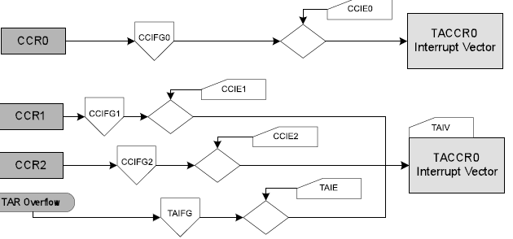
Timer_A Interrupt Vectors (TAIV)
TACCR0 interrupt vector for CCIFG of CCR0
TAIV interrupt vector for TAIFG and CCIFGs of CCR1,CCR2

Slide 50
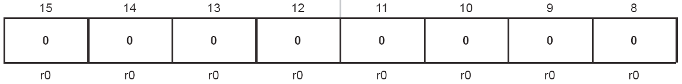
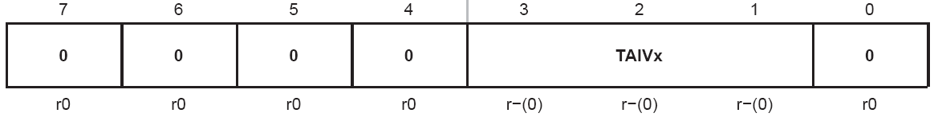
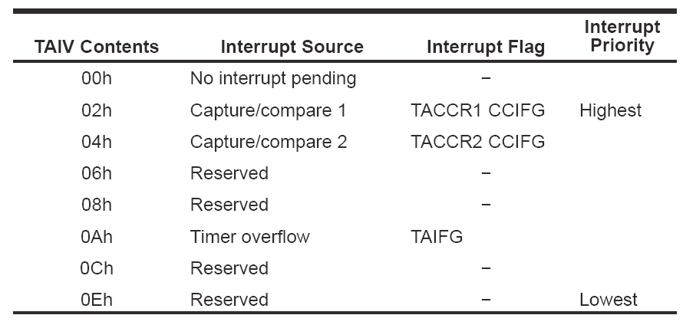
TAIV, Timer_A Interrupt Vector Register

Slide 51
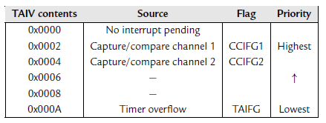
Interrupts can be generated by the timer block itself (flag TAIFG) and each
capture/compare channel (flag TACCRn CCIFG or CCIFGn for short).
TACCR0 is privileged and has its own interrupt vector, TIMERA0_VECTOR.

Slide 52
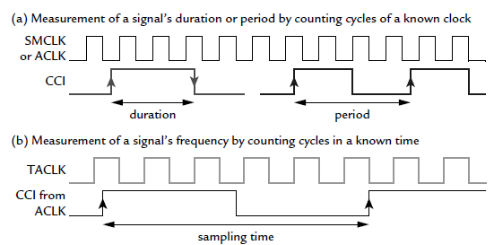
Measurement of Capture mode
Two ways in which the Capture mode is used to time a signal.
(a) The duration or period of the signal CCI is measured by counting the number of cycles of a known clock.
(b) The frequency of the external signal TACLK is measured by using
it as the clock and counting the number of cycles during a known interval

Slide 53
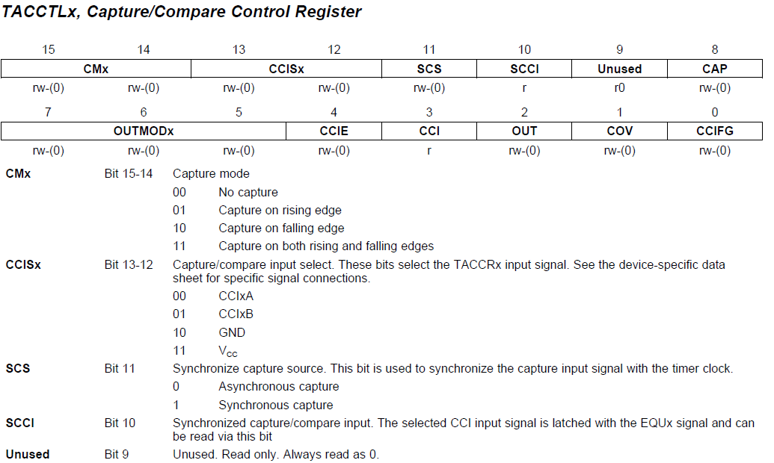
TACCTL

Slide 54
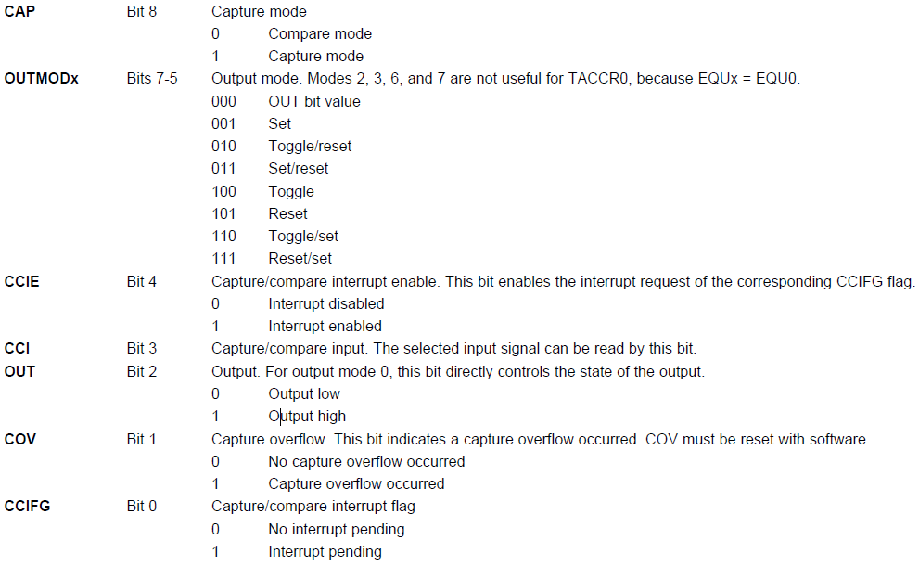
TACCTL cont’d

Slide 55
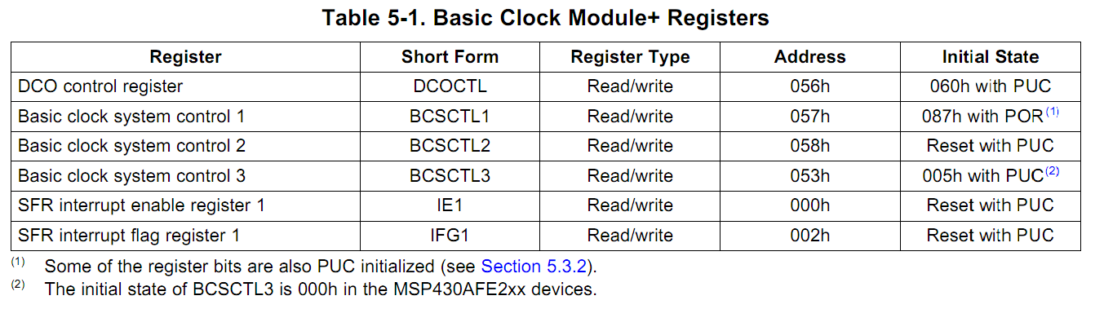
Control Registers for Clocks
Control Registers for Clock System
DCOCTL and BCSCTL1 combined define the frequency of DCO, among other settings
Notes:
Table 5-1 @ userguide, page 282

Slide 56
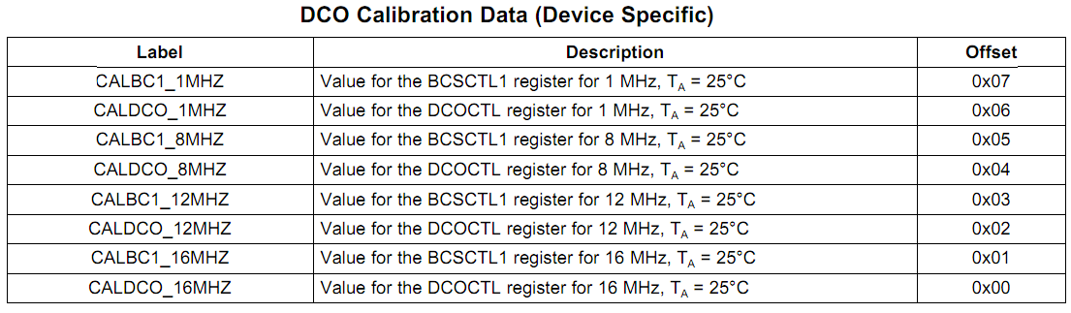
Simple Setting of DCO
Can use Tag-Length-Value (TLV) that are stored in the flash memory to set DCOCTL and BCSCTL1 for DCO frequency
BCSCTL1 = CALBC1_1MHZ; // Set range DCOCTL = CALDCO_1MHZ;
Notes:
The Tag-Length-Value (TLV) structure is used in selected MSP430x2xx devices to provide device-specific information in the device’s flash memory SegmentA, such as calibration data. For the device-dependent Implementation, see the device-specific data sheet. (@ chapter 24, userguide, page 587)
For DCO calibration, the BCS+ registers (BCSCTL1 and DCOCTL) are used. The values stored in the flash information memory SegmentA are written to the BCS+ registers

Slide 57
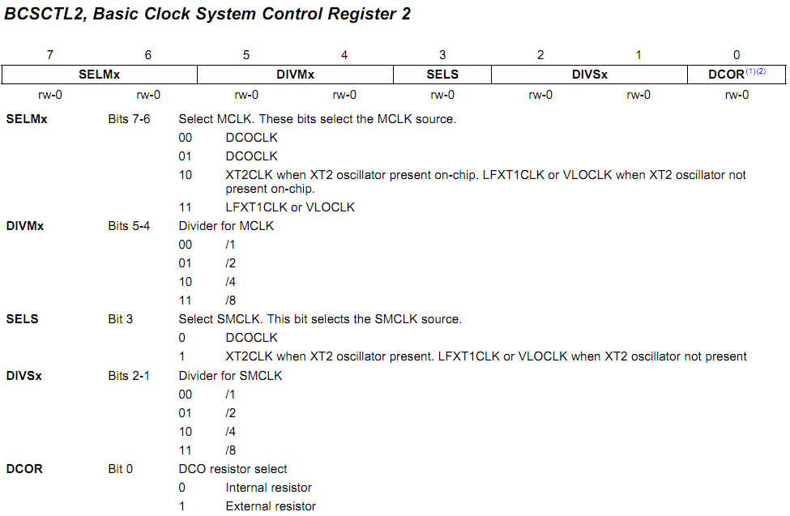
BCSCTL2
MCLK
SMCLK
BCSCTL2 |= SELM_3 + DIVM_3; // MCLK = VLO/8
Notes:
(1) Does not apply to MSP430x20xx or MSP430x21xx devices.
(2) This bit is reserved in the MSP430AFE2xx devices

Slide 58
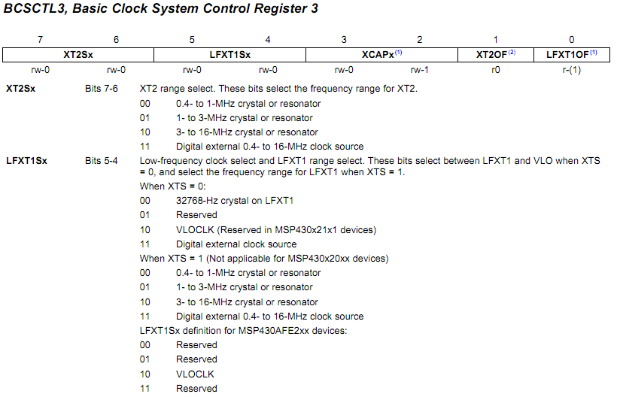
BCSCTL3
In MSP430G2231
BCSCTL3 |= LFXT1S_2; // Enable VLO as MCLK/ACLK src
Notes:
MSP430x22xx, MSP430x23x0: XT2 is not present
(1) This bit is reserved in the MSP430AFE2xx devices.
(2) Does not apply to MSP430x2xx, MSP430x21xx, or MSP430x22xx devices.

Slide 59
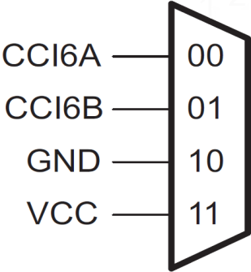
Timer_A7 Summary
15 |  |  |  |  |  |  |  |  |  |  |  |  | 0
Divide
by 5-bits
(up to ÷ 64)
16-bit Counter
(TAR)
Enable
(TAIE)
Interrupt
(TAIFG)
CC0IE
CC0IFG
CAP=0
CCR0
TA0.0
.
.
.
CAP=1
CM
SCS
COV
CC6IE
CC6IFG
CCR6
TA0.6
Timer0_A7:
Is the first instance (Timer0 or TA0) of Timer_A7 on the device
_A7 means it has 7 Capture/Compare Registers (CCR’s)
CCR registers can be configured for:
Compare (set when CAP=0) generates interrupt (CCnIFG) and modifies OUT signal when TAR = CCRn
Capture (when CAP=1) grabs the TAR value and sets an interrupt (CCnIFG) when triggered by the selected CCIx input

Slide 60
Timer_A3
Async 16-Bit timer/counter available on all MSP430s
Count modes:
Continuous
Up-down
Up
Multiple capture/compare registers (CCR_{n}); each can provide:
Interval timing
Generate interrupt
Combined for complex signal generation
PWM outputs
Interrupt vector register for fast INT decoding
Direct connection to DMA and many peripherals:
Increases determinism
Lowers power dissipation
Notes:
Asynchronous 16-bit timer/counter with four operating modes
Selectable and configurable clock source
Three configurable capture/compare registers
Configurable outputs with PWM capability
Asynchronous input and output latching
Interrupt vector register for fast decoding of all Timer_A interrupts
DMA enabled

Slide 61
4 Steps to Program Timer_A
Timer Setup Code
Configure Timer/Counter (TACTL)
Clocking
Which Count Mode
Interrupt on TAR rollover?
Setup Capture and/or Compare Registers
Capture (TACCTL):
Input
Interrupt on Capture?
Compare (TACCTL, TACCR):
Compare-to Value
Output mode (How output signal changes at compare (EQU) events)
Interrupt on Compare?
Clear interrupt Flags & Start Timer
Timer Interrupt Service Routine(s)
Write 1-2 ISR’s (CCR0, others)
Timer_A Ctrl Reg (TACTL)
16-bit Counter (TAR)
CCR0 Ctrl Reg (TACCTL0)
CCR0 (TACCR0)
.
.
.
CCR6 Ctrl Reg (TACCTL6)
CCR6 (TACCR6)
Notes:
Finally, Step 4.
If you’re generating interrupts with the timer, you’ll need to have one or two ISR’s.
(While interrupts were covered in the last chapter, we briefly summarize this again in context of the Timer_A.)
BTW, we’ll examine more of the timer’s features as we look at the timer’s setup code.

Slide 62
1. Configure Timer/Counter
15 |  |  |  |  |  |  |  |  |  |  |  |  | 0
Divide
by 5-bits
(up to ÷ 64)
16-bit Counter
(TAR)
Enable
(TAIE)
Interrupt
(TAIFG)
Timer_A_initContinuousModeParam initParam = { 0 };
initParam.clockSource = TIMER_A_CLOCKSOURCE_ACLK;
initParam.clockSourceDivider = TIMER_A_CLOCKSOURCE_DIVIDER_1;
initParam.timerInterruptEnable_TAIE = TIMER_A_TAIE_INTERRUPT_ENABLE;
initParam.timerClear = TIMER_A_DO_CLEAR;
initParam.startTimer = false;
Timer_A_initContinuousMode( TIMER_A0_BASE, &initParam );
Notes:
Parameter four lets you decide whether to interrupt the CPU when the counter (TA0R) rolls over to zero.
This parameter ends up setting the TA0IE bit.

Slide 63
1. Configure Timer/Counter
15 |  |  |  |  |  |  |  |  |  |  |  |  | 0
Divide
by 5-bits
(up to ÷ 64)
16-bit Counter
(TAR)
Enable
(TAIE)
Interrupt
(TAIFG)
Timer_A_initContinuousModeParam initParam = { 0 };
initParam.clockSource = TIMER_A_CLOCKSOURCE_ACLK;
initParam.clockSourceDivider = TIMER_A_CLOCKSOURCE_DIVIDER_1;
initParam.timerInterruptEnable_TAIE = TIMER_A_TAIE_INTERRUPT_ENABLE;
initParam.timerClear = TIMER_A_DO_CLEAR;
initParam.startTimer = false;
Timer_A_initContinuousMode( TIMER_A0_BASE, &initParam );
Clear TAR counter or Not?
Notes:
Finally, do you want to have the timer counter register (TA0R) reset when the other parameters are configured?
… or to be left alone with whatever count value it already contains.

Slide 64
15 |  |  |  |  |  |  |  |  |  |  |  |  | 0
Divide
by 5-bits
(up to ÷ 64)
16-bit Counter
(TAR)
Enable
(TAIE)
Interrupt
(TAIFG)
Timer_A_initContinuousModeParam initParam = { 0 };
initParam.clockSource = TIMER_A_CLOCKSOURCE_ACLK;
initParam.clockSourceDivider = TIMER_A_CLOCKSOURCE_DIVIDER_1;
initParam.timerInterruptEnable_TAIE = TIMER_A_TAIE_INTERRUPT_ENABLE;
initParam.timerClear = TIMER_A_DO_CLEAR;
initParam.startTimer = false;
Timer_A_initContinuousMode( TIMER_A0_BASE, &initParam );
Automatically start the timer after initialization
Notes:
Finally, do you want to have the timer counter register (TA0R) reset when the other parameters are configured?
… or to be left alone with whatever count value it already contains.

Slide 65
Timer Code Example (Part 1)
#include <driverlib.h>
void main(void) {
// Setup/Hold Watchdog Timer (WDT+ or WDT_A)
initWatchdog();
// Configure GPIO ports/pins
initGPIO();
// Setup Clocking: ACLK, SMCLK, MCLK (BCS+, UCS, or CS)
initClocks();
//----------------------------------------------------------
// Then, configure any other required peripherals and GPIO
initTimers();
__bis_SR_register( GIE );
while(1) {
...
}
Notes:
OK, stepping back… somewhere in your program … maybe at the beginning of main(), you’ll want to configure your timers.
In this example, it looks like we’re doing that in a function called, initTimerA0().

Slide 66
Timer_A7: Capture Mode
15 |  |  |  |  |  |  |  |  |  |  |  |  | 0
Divide
by 5-bits
(up to ÷ 64)
16-bit Counter
(TAR)
Enable
(TAIE)
Interrupt
(TAIFG)
CCR0
Capture or Compare (CAP) CAP=1 for capture
Which Edge (CM) Rising, Falling, or Both
Sync’d to Clock (SCS) Is capture sync or async?
Capture Overflow (COV) Did you miss a capture?
CCR1
CCR2
CCR3
CCR4
CCR5
CAP=1
CM
SCS
COV
CCR6
CC6IE
Interrupt
(CC6IFG)

Slide 67
Timer_A7: Compare Mode
15 |  |  |  |  |  |  |  |  |  |  |  |  | 0
Divide
by 5-bits
(up to ÷ 64)
16-bit Counter
(TAR)
Enable
(TAIE)
Interrupt
(TAIFG)
CCR0
CCR1
CCR2
CCR3
CCR4
CCR5
CCR6
Notes:
So, for an example, let’s say we want to setup CCR2 for COMPARE mode.
That is, we want to compare CCR2 to the timer/counter (TAR) and effect some action when they match.

Slide 68
Timer_A7: Compare Mode
15 |  |  |  |  |  |  |  |  |  |  |  |  | 0
Divide
by 5-bits
(up to ÷ 64)
16-bit Counter
(TAR)
Enable
(TAIE)
Interrupt
(TAIFG)
CCR0
CCR1
Enable
(CC2IE)
Interrupt
(CC2IFG)
CAP=0
CCR2
OUT
(TA0.2)
OUT
(TA0.2)
CAP=0 (Capture off) Compare mode on
If CCR2 = TAR (named EQU2):
Interrupt occurs (if enabled)
OUT is set/reset/toggled
OUT can be:
Connected to pin (TA0.2)
Routed to peripherals
OUT bit can be polled ☹
CCR3
CCR4
CCR5
CCR6
Notes:
Also, the timer’s OUTput signal (TA0.2, in this case) is modified by EQU2.
This signal is available to other internal peripherals … for example, this signal could be used by many MSP430 devices to initiate an Analog to Digital conversion… or a DMA transfer.
Also, this signal can be routed to a pin… in this case, it would be called TA0.2
How this signal appears on the pin is very flexible. In just a minute, we’ll examine the various PIN output modes you can select from.

Slide 69
Timer_A7 Summary
15 |  |  |  |  |  |  |  |  |  |  |  |  | 0
Divide
by 5-bits
(up to ÷ 64)
16-bit Counter
(TAR)
Enable
(TAIE)
Interrupt
(TAIFG)
CC2IE
CC2IFG
CAP=0
CCR2
TA0.2

Slide 70
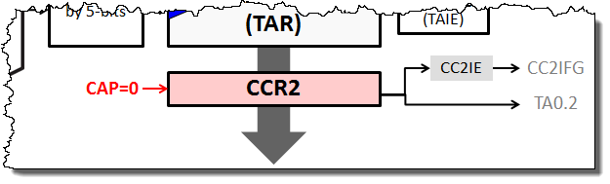
Timer Code Example (Part 2 - Compare)
1
TIMER_A_initCompare( TIMER_A0_BASE,
TIMER_A_CAPTURECOMPARE_REGISTER_2,
TIMER_A_CAPTURECOMPARE_INTERRUPT_ENABLE,
TIMER_A_OUTPUTMODE_SET_RESET,
0xBEEF // Compare Value
);
Notes:
For our example, we chose the outputmode called: “Set/Reset”
Once again, with so many different output mode choices, we’ll come back and speak more about this in just a minute or two.

Slide 71
Timer Code Example (Part 2 - Compare)
1
TIMER_A_initCompare( TIMER_A0_BASE,
TIMER_A_CAPTURECOMPARE_REGISTER_2,
TIMER_A_CAPTURECOMPARE_INTERRUPT_ENABLE,
TIMER_A_OUTPUTMODE_SET_RESET,
0xBEEF // Compare Value
);
Writes 0xBEEF to CCR2
Notes:
Finally, what COMPARE-to value do you want to set into the CCR2 register?
We chose a funny looking number. Well, that is unless you’re a vegetarian.
In a real application, though, you would actually pick this number based upon whatever timing was needed for your system.

Slide 72
Timer Code Example (Part 2 - Compare)
#include <driverlib.h>
void initTimerA0(void) {
// Setup TimerA0 in Up mode with CCR2 compare
TIMER_A_configureUpMode( TIMER_A0_BASE,
TIMER_A_CLOCKSOURCE_SMCLK,
TIMER_A_CLOCKSOURCE_DIVIDER_1,
TIMER_PERIOD,
TIMER_A_TAIE_INTERRUPT_ENABLE,
TIMER_A_CCIE_CCR0_INTERRUPT_ENABLE,
TIMER_A_DO_CLEAR );
TIMER_A_initCompare( TIMER_A0_BASE,
TIMER_A_CAPTURECOMPARE_REGISTER_2,
TIMER_A_CAPTURECOMPARE_INTERRUPT_ENABLE,
TIMER_A_OUTPUTMODE_SET_RESET,
0xBEEF // Compare Value
);
}
1
Writes 0xBEEF to CCR2

Slide 73
Timer Code Example (Part 2 - Compare)
#include <driverlib.h>
void initTimerA0(void) {
// Setup TimerA0 in Up mode with CCR2 compare
TIMER_A_configureUpMode( TIMER_A0_BASE,
TIMER_A_CLOCKSOURCE_SMCLK,
TIMER_A_CLOCKSOURCE_DIVIDER_1,
TIMER_PERIOD,
TIMER_A_TAIE_INTERRUPT_ENABLE,
TIMER_A_CCIE_CCR0_INTERRUPT_ENABLE,
TIMER_A_DO_CLEAR );
TIMER_A_initCompare( TIMER_A0_BASE,
TIMER_A_CAPTURECOMPARE_REGISTER_2,
TIMER_A_CAPTURECOMPARE_INTERRUPT_ENABLE,
TIMER_A_OUTPUTMODE_SET_RESET,
0xBEEF // Compare Value
);
}
1
2
Notes:
Adding this to our previous timer code, here’s a summary of what we have thus far.
Part 1 of our code configures the timer/counter; i.e. the main counter control register of Timer_A.
Part 2 configures the various Capture/Compare registers (CCR).
Due to limited space on the slide we only set up CCR2. In a real application, you might use all of the CCR registers – in which case, you would need to call the TIMER_A_initCompare (or initCapture) functions multiple times.

Slide 74
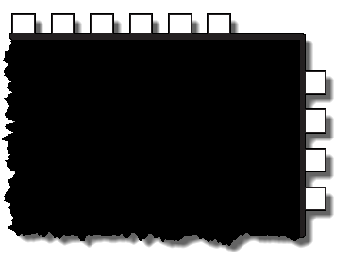
OUTMODE determine OUT’s Value
TIMER_A_initCompare( TIMER_A0_BASE,
TIMER_A_CAPTURECOMPARE_REGISTER_2,
TIMER_A_CAPTURECOMPARE_INTERRUPT_ENABLE,
TIMER_A_OUTPUTMODE_SET_RESET,
0xBEEF
);
 |  |  |  |  |  |  |  | 7 | 6 | 5 |  |  | 2
CM |  | CCIS |  | SCS | SCCI | rsv | CAP | OUTMOD |  |  | CCIE | CCI | OUT | COV | CCIFG
Timer_Ax Capture/Compare Control Register n (TAxCCTLn)
21
22
23
24
P1.0 / TA0CLK / ACLK
P1.1 / TA0.0
P1.2 / TA0.1
P1.3 / TA0.2
Notes:
On a previous slide, we saw that the timer has an output signal OUT – which can be used to drive an internal peripheral … or a PIN.
For example, on the ‘F5529, CCR2 from Timer0_A can drive PIN 24.

Slide 75
OUTMOD determine OUT’s Value
TIMER_A_initCompare( TIMER_A0_BASE,
TIMER_A_CAPTURECOMPARE_REGISTER_2,
TIMER_A_CAPTURECOMPARE_INTERRUPT_ENABLE,
TIMER_A_OUTPUTMODE_SET_RESET,
0xBEEF
);
 |  |  |  |  |  |  |  | 7 | 6 | 5 |  |  | 2
CM |  | CCIS |  | SCS | SCCI | rsv | CAP | OUTMOD |  |  | CCIE | CCI | OUT | COV | CCIFG
13.3.3 Timer_Ax Capture/Compare Control Register n (TAxCCTLn)
21
22
23
24
P1.0 / TA0CLK / ACLK
P1.1 / TA0.0
P1.2 / TA0.1
P1.3 / TA0.2
Notes:
As we show here, setting the OUTPUT MODE actually sets the OUTMOD field in the TIMER_A0’s Capture&Compare Control Register 2.
The OUTPUT MODE settings determine how the OUT signal changes whenever a COMPARE MATCH occurs.
Let’s look at the first OUTPUT MODE…

Slide 76
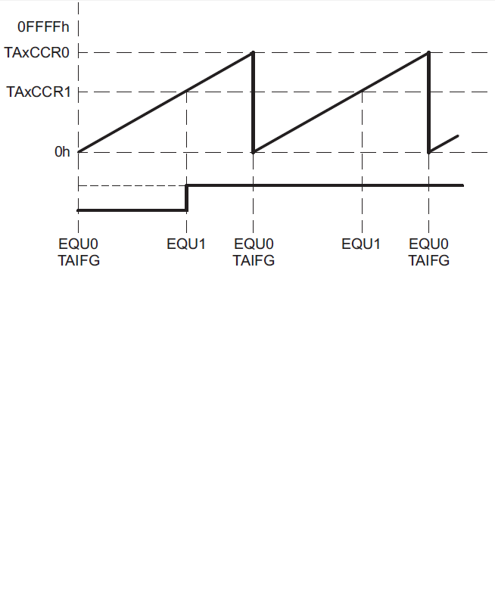
Timer CCR (Compare) Output Mode 01
Each CCR has it’s own signal (e.g. TA0.1)
Input for capture (CCI)
Output for compare (OUT)
Used as output, the value in register bit CCRn.
OUT is routed to TA0.n
Value of OUT is affected by Output Mode (CCRn.OUTMOD)
If OUTMOD=0, then OUT bit (and hence the signal) is under software control
Notes:
If OUTMOD = 0, then OUT is not changed by the timer’s hardware. That is, it’s under software control. You can set OUT to whatever you like by writing to the register.

Slide 77
Output Mode
(CCRn.OUTMOD)
01
Note: Interrupts don’t vary with OUTMOD, only the OUTput signal changes
Output Mode 1
OUTMOD = 01 is called “Set”
This means that OUT (e.g. TA0.1) is set on EQU1
That is, whenever TAR=CCR1
Notes:
OK, so then what happens to OUT when OUTMOD = 1?
Well, first, let’s look at what happens TAR = CCR1.
Notice, when the timer/counter (TAR) counts up to the value in CCR1 (i.e. TAR = CCR1), then a valid comparison is true. The user guide calls the state EQU1 (for CCR1 is EQUAL to the counter). Similarly, we can see that when the counter reaches the value in CCR0, they call this EQU0.

Slide 78
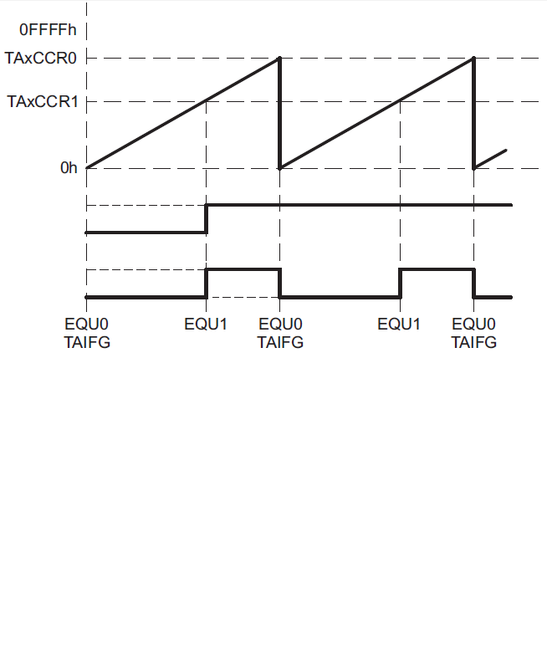
Timer CCR (Compare) Output Mode 02
Output Mode 02 is called:
Output Mode
(CCRn.OUTMOD)
01 | Set
02 | Toggle/ Reset
Toggle | / | Reset
Toggles OUT on EQUn
Notes:
OUTMOD = 2 is called the “Toggle/Reset” mode
It’s a bit more interesting than the previous output modes, for each of these names (toggle and reset) corresponds to a different event.
You can see, here we have the first event. When the counter = CCR1 (i.e. EQU1) then OUT is toggled.

Slide 79
Timer CCR (Compare) Output Mode 02
Output Mode 02 is called:
Output Mode
(CCRn.OUTMOD)
01 | Set
02 | Toggle/ Reset
Toggle | / | Reset
Toggles OUT on EQUn |  | Resets OUT on CCR0
Notes:
The second event is when counter reaches CCR0.
When this happens, the second action (in this case “Reset”) occurs.

Slide 80
Timer CCR (Compare) Output Mode 02
OUT is actually affected by two events:
EQUn : when TAR=CCRn
EQU0 : when TAR=CCR0
In other words, the two events are CCRnIFG and CCR0IFG, respectively
Output Mode 02 is called:
Output Mode
(CCRn.OUTMOD)
01 | Set
02 | Toggle/ Reset
Toggle | / | Reset
Toggles OUT on EQUn |  | Resets OUT on CCR0
Output Mode 2
OUTMOD = 02 is called “Toggle/Reset”
This means that OUT (e.g. TA0.1) is Toggled upon EQU1
And Reset on EQU0 (i.e. CCR0 match)
Notes:
In other words, when the OutputModes are defined by two names, the first one dictates the value of OUT whenever that CCR = TAR.
The second name describes what happens to OUT whenever CCR0 = TAR.

Slide 81
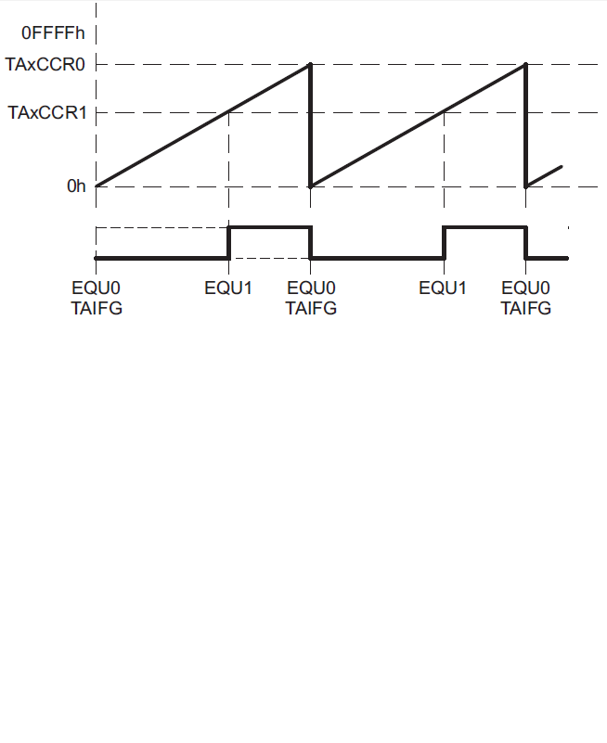
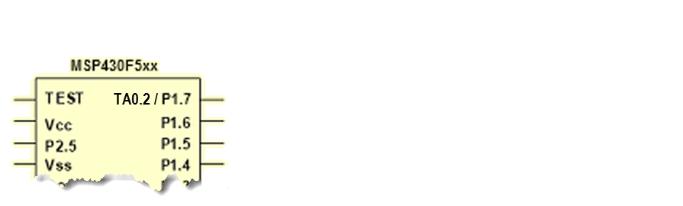
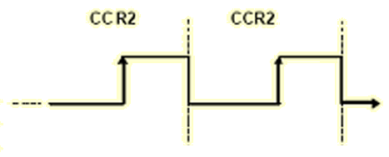
Timer CCR (Compare) Output Mode 02
OUT is actually affected by two events:
EQUn : when TAR=CCRn
EQU0 : when TAR=CCR0
In other words, the two events are CCRnIFG and CCR0IFG, respectively
Output Mode 02 is called:
Toggle/Reset
Output Mode
(CCRn.OUTMOD)
02 | Toggle/ Reset
Here’s an example of routine TA0.2 (i.e. OUT2) to a GPIO pin:
Completely automatic
Independent frequencies with different duty cycles can be generated for each CCR

Slide 82
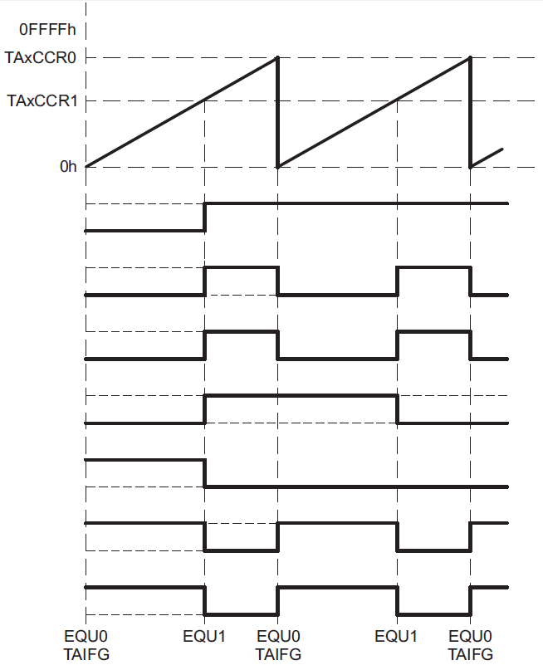
Capture “Output Modes” Summary
Use different OUTMOD settings to create various signal patterns
Output modes 2, 3, 6, and 7 are not useful for output unit 0 because EQUn = EQU0
This summary is for the “UP” mode. User’s Guide has similar diagrams for Continuous and UpDown counter modes
Output Mode
(CCRn.OUTMOD)
01 | Set
02 | Toggle/ Reset
03 | Set/ Reset
04 | Toggle
05 | Reset
06 | Toggle/Set
07 | Reset/Set
Do these look like PWM signals?
Here's a simple PWM example...
Notes:
While we have only studied a couple of the output modes, we hope you’ll now be able to decipher the remaining modes based upon their names.
Here’s a graphical comparison of all the different OUTput waveforms based upon the value of OUTMOD.

